Slide 1

ECON 3105 - Big Data Analytics
Default of credit card clients
Group 8
Féliz LUBERNE 22508775

Slide 2
Plan
01
02
03
04
Introduction
Research question
Data handling and analysis
The corresponding results
Intro
R. question
Data handling
Conclusion

Slide 3
Introduction
Intro
R. question
Data handling
Conclusion
Data set informations
Data set Characteristics: | Multivariate | Number of Instances: | 30000 | Area: | Business
Attribute Characteristics: | Integer, Real | Number of attributes: | 24 | Data Donated: | 12 January, 2009
Associated Tasks: | Classification | Missing Values: | N/A | Number of Web Hits: | 764524
Data : default of credit card clients

Slide 4
Overview - Credit Card Default
Intro
R. question
Data handling
Conclusion
A situation where a cardholder fails to settle a payment on their credit card debt.
The financial wellbeing of a person may suffer long-term effects from defaulting on a credit card.
Poses as a risk to financial institutions - loss when client defaults on credit card payment.
Affects institution’s reputation and financial health

Slide 5
Research question
Intro
R. Question
Data handling
Conclusion
What factors influence the probability of customer default in Taiwan?
Credit card is a common payment method and credit card default is not uncommon
This question is crucial because:
Major economic and social consequences —> loss for the financial situation while substantially affects the borrower’s financial stability
Identification of factors aids financial institutions in developing effective and efficient management strategies.
Taiwan high use of credit cards and credit card debt is a common issue.
Information can be used to improve public policy and economic situation of the country.

Slide 6
Data handling
Intro
R. Question
Data handling
Conclusion
Total at the end = Sum ‘Bill_AMT1’:’Bill_AMT6’ - ‘Pay_AMT1’:’Pay_AMT6’
Head of the data
data.head()
ID | LIMIT_BAL | SEX | EDUCATION | MARRIAGE | AGE | PAY_0 | ... | BILL_AMT6 | … | PAY_AMT6 | default payment next month
0 | 1 | 20000 | 2 | 2 | 1 | 24 | … | 0 | … | 0 | 0
1 | 2 | 120000 | 2 | 2 | 2 | 26 | … | 3455 | … | 0 | 2000
2 | 3 | 90000 | 2 | 2 | 2 | 34 | … | 14948 | … | 1000 | 5000
3 | 4 | 50000 | 2 | 2 | 1 | 37 | … | 28959 | … | 1069 | 1000
4 | 5 | 50000 | 1 | 2 | 1 | 57 | … | 19146 | … | 689 | 679
Total at the end
7015
12077
90635
222946
50290

Slide 7


Data handling
Logistic Regression
Decision Tree
Intro
R. Question
Data handling
Conclusion
2 models
In the case of credit card default prediction, we will first use logistic regression to model the probability that a customer will default as a function of variables.
In the case of credit card default prediction, decision trees are often used to model the probability of a customer defaulting based on variables.

Slide 8
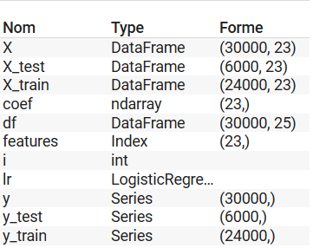
Data handling
Intro
R. Question
Data handling
Conclusion
The coefficients

Slide 9
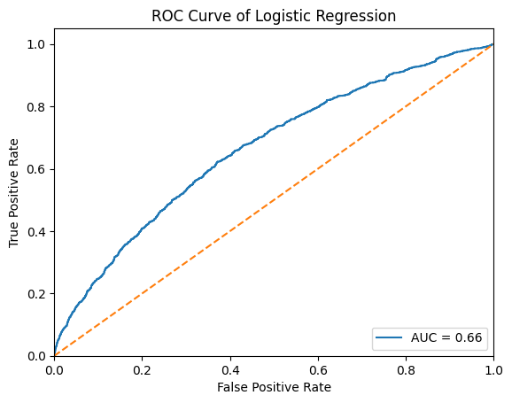
Data handling
Intro
R. Question
Data handling
Conclusion
ROC Curves
the AUC is 0,66. This indicates that the binary classification model has an average performance. The closer the AUC is to 1, the better the performance of the model.

Slide 10
Data handling
Intro
R. Question
Data handling
Conclusion
Decision Tree
Accuracy : 0.7255
precision | recall | f1-score | support
Best parameters
max_depth': | 3
min_samples_leaf': | 1
min_samples_split': | 2
0 | 0.83 | 0.81 | 0.82 | 4687
1 | 0.38 | 0.41 | 0.39 | 1313
accuracy |  |  | 0.73 | 6000
Macro avg | 0.61 | 0.61 | 0.61 | 6000
Weighted avg | 0.73 | 0.73 | 0.73 | 6000
Best score: | 0.8207500000000001

Slide 11
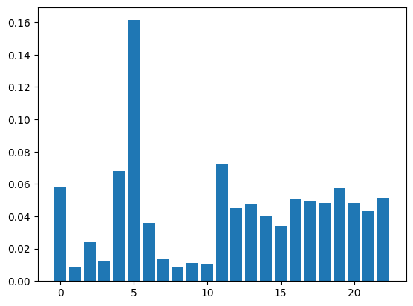
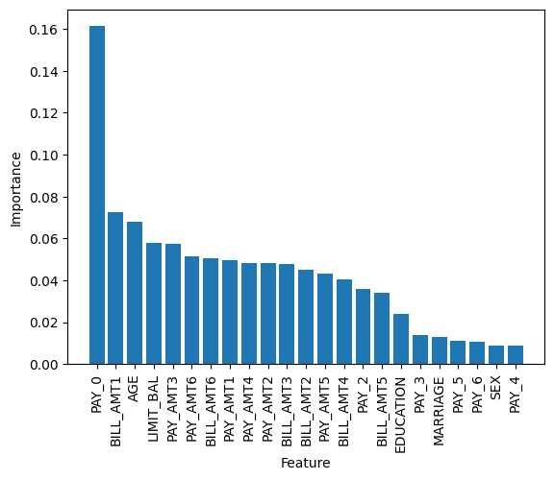
Data handling
Intro
R. Question
Data handling
Conclusion
Decision Tree

Slide 12
Data handling
Intro
R. Question
Data handling
Conclusion
Logistic regression VS Decision Tree
Confusion matrix | [[7040 0] [1959 1]]
Precision | 1.0
Recall | 0.0005102040816326531
F1 score | 0.0010198878123406426
Confusion matrix | [[3816 871] [770 5431]]
Precision | 0.384016973125884
Recall | 0.4135567402894136
F1 score | 0.39823982398239827
V
S
Notes:
Decision tree because more balanced

Slide 13
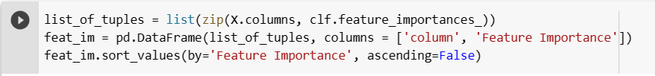
Conclusion
Intro
R. Question
Data handling
Conclusion
Feature Numbers (ex: X1 = 1) | column | Feature Importance
5 | PAY_0 | 0,161301
11 | BILL_AMT1 | 0,072284
4 | AGE | 0,067848
0 | LIMIT_BAL | 0,057646
19 | PAY_AMT3 | 0,057545
22 | PAY_AMT6 | 0,051632
16 | BILL_AMT6 | 0,050612
51,9%

Slide 14

Conclusion
Intro
R. Question
Data handling
Conclusion
The repayment status in September
(16,13%)
Amount of bill statement in September
(7,23%)
PAY_0
Age
(6,80%)
Amount of the given credit
(5,80%)
BILL_AMT1
AGE
LIMIT_BAL
4

Slide 15
Thank you!

